Slide 1
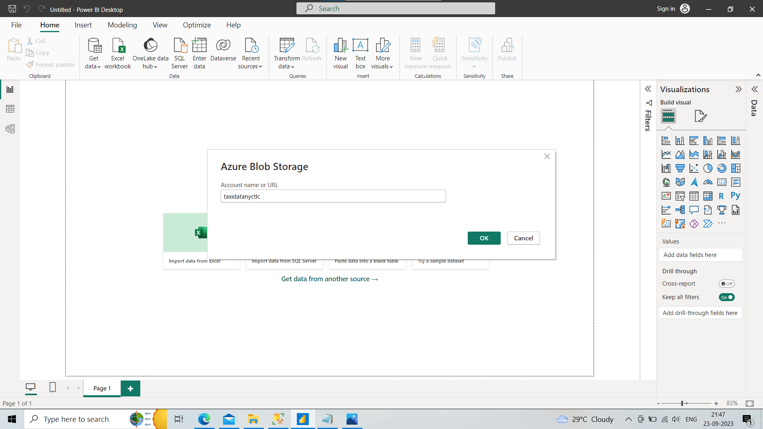
Connecting power bi with data source
Click on get data
Click azure
Azure data lake gen2

Slide 2
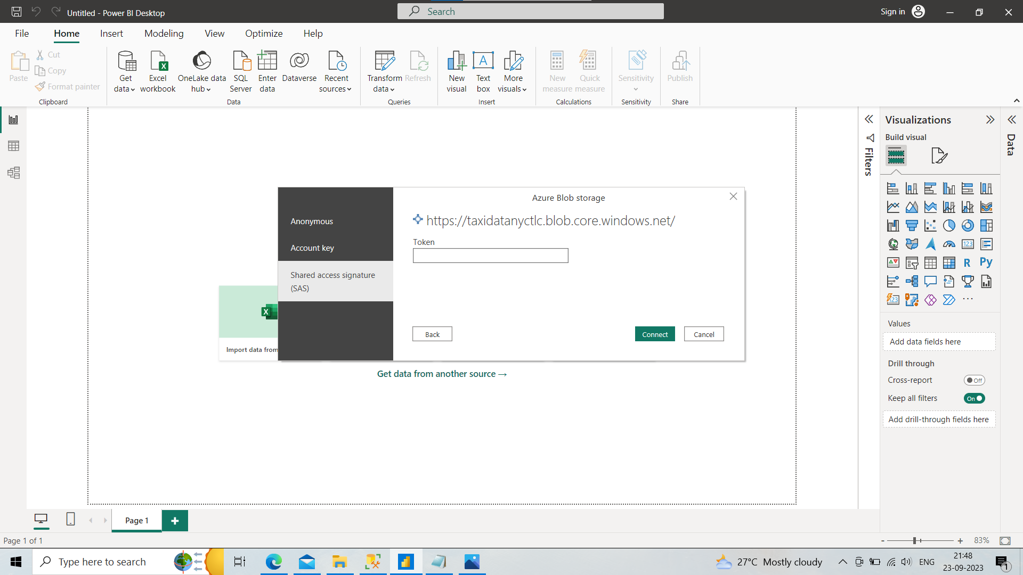
After providing storage account name click ok
Select Sas
Provide the key , copy from azure storage account security and networking set also expiry date

Slide 3
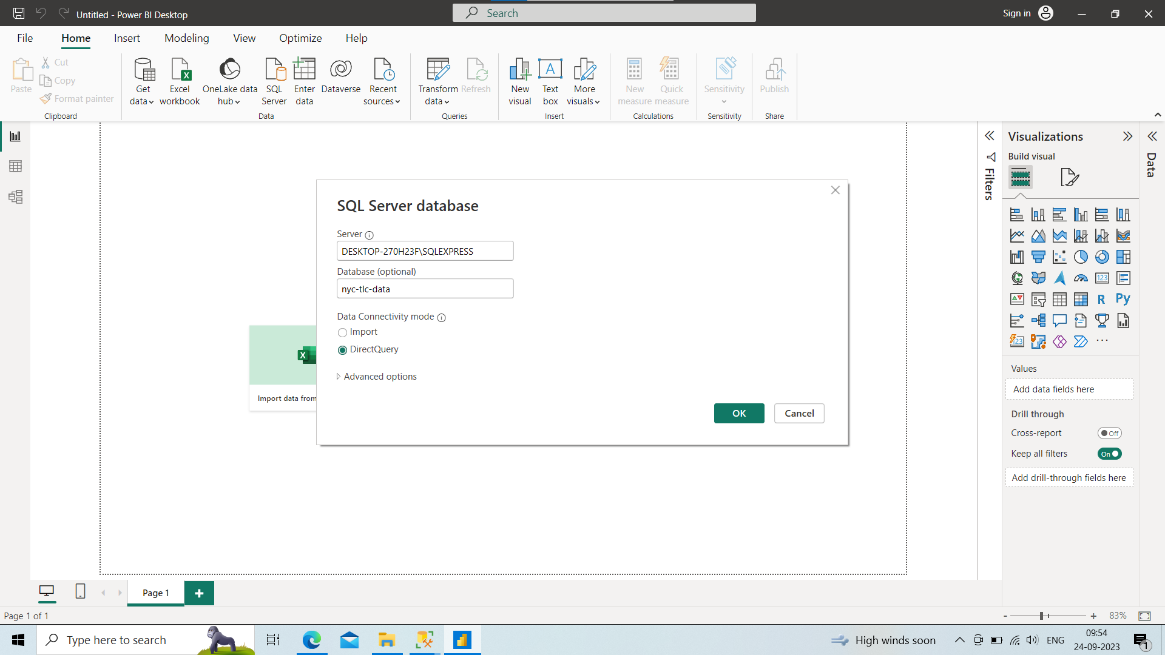
As here I am using sql as my source I will connect sql server
Get data
Sql server

Slide 4
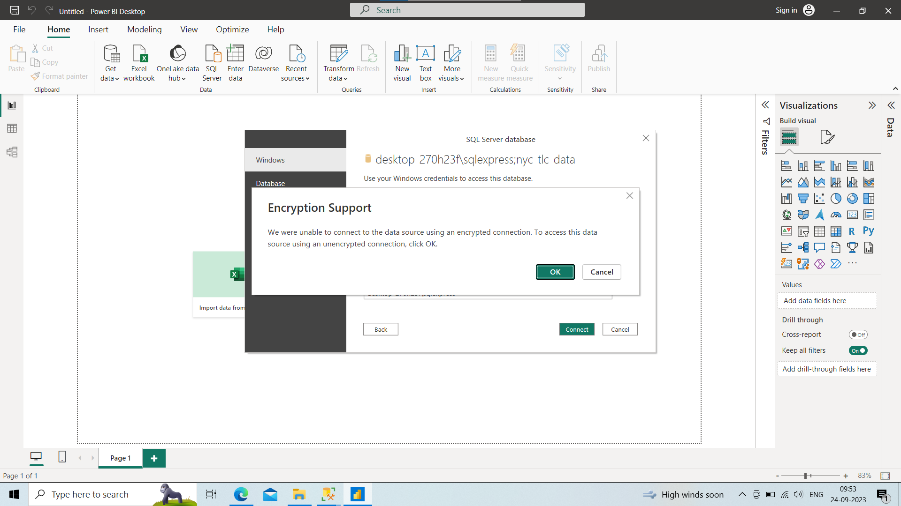
It will fetch credentials as windows authentication click on connect

Slide 5
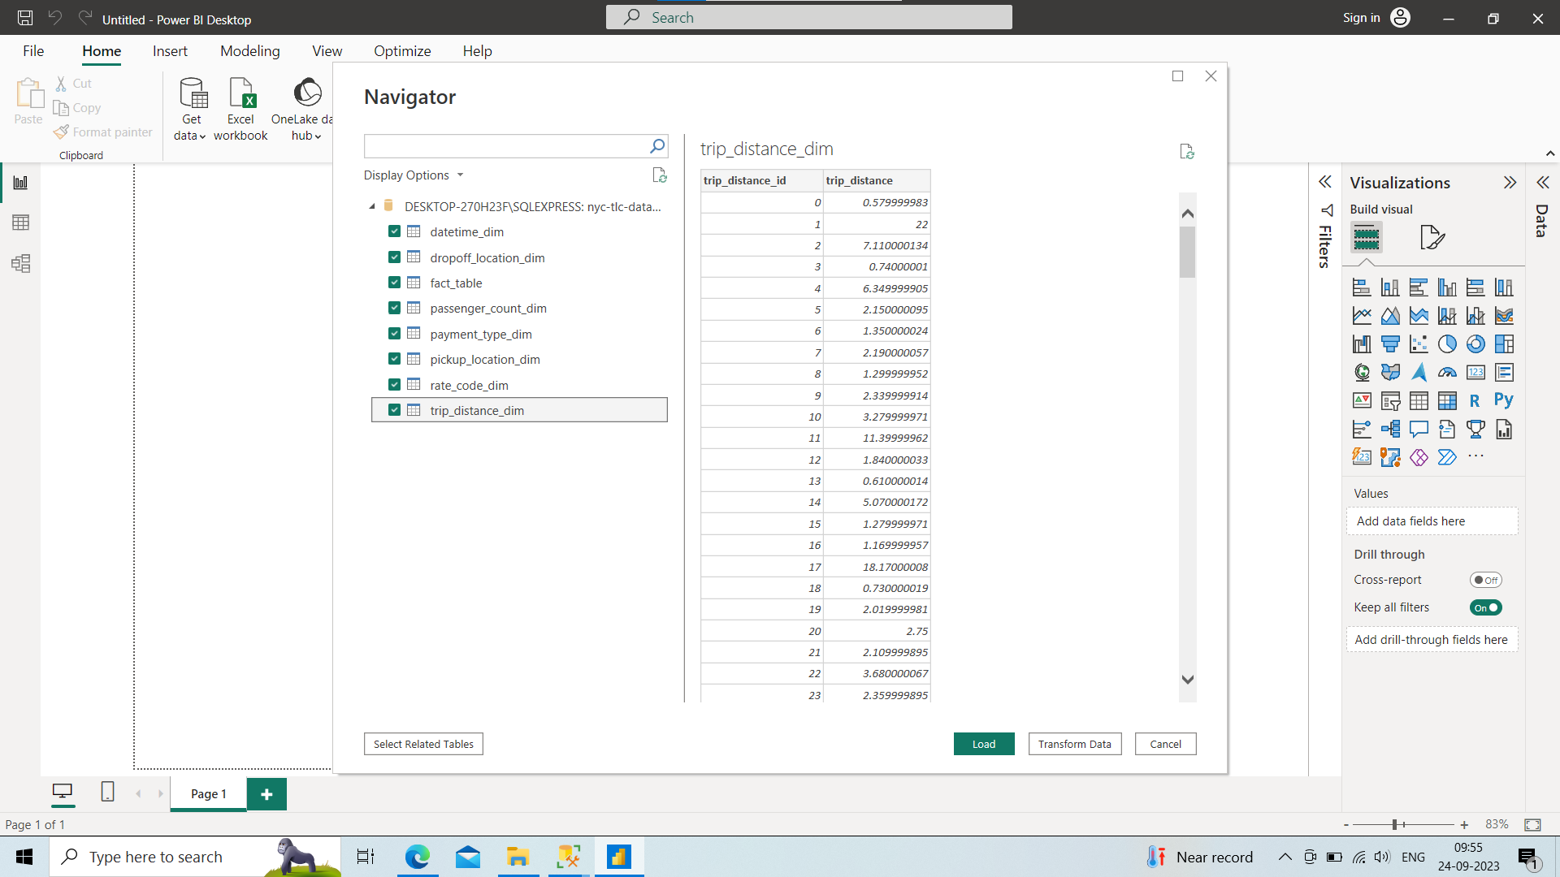
Select all
Click load

Slide 6
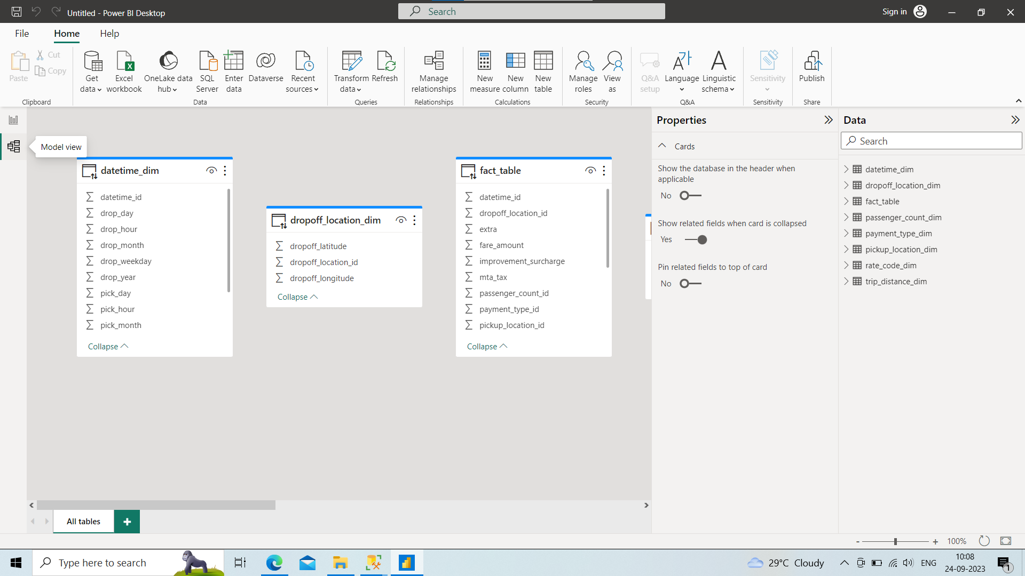
Click on model view
To stablish relationship between tables.

Slide 7
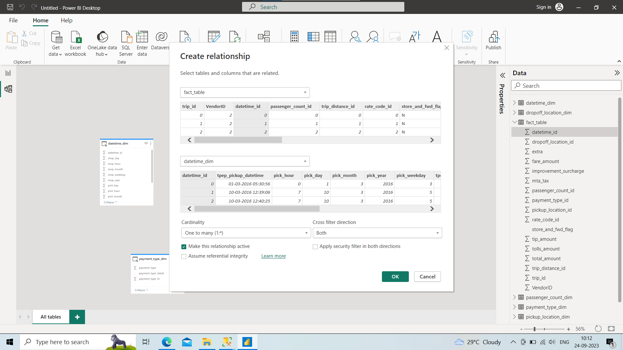
Drag and drop the fk of fact table to pk of dim table

Slide 8
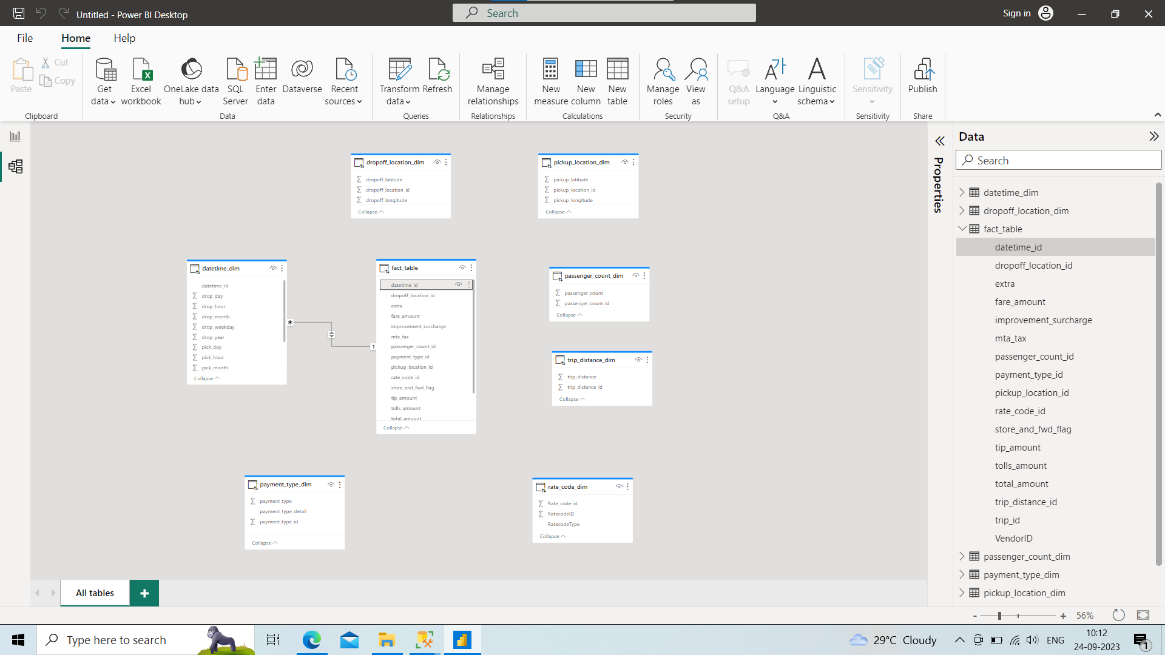
Arranging all in a star schema
Connect with foreign keys of fact tale to primary key of other table

Slide 9
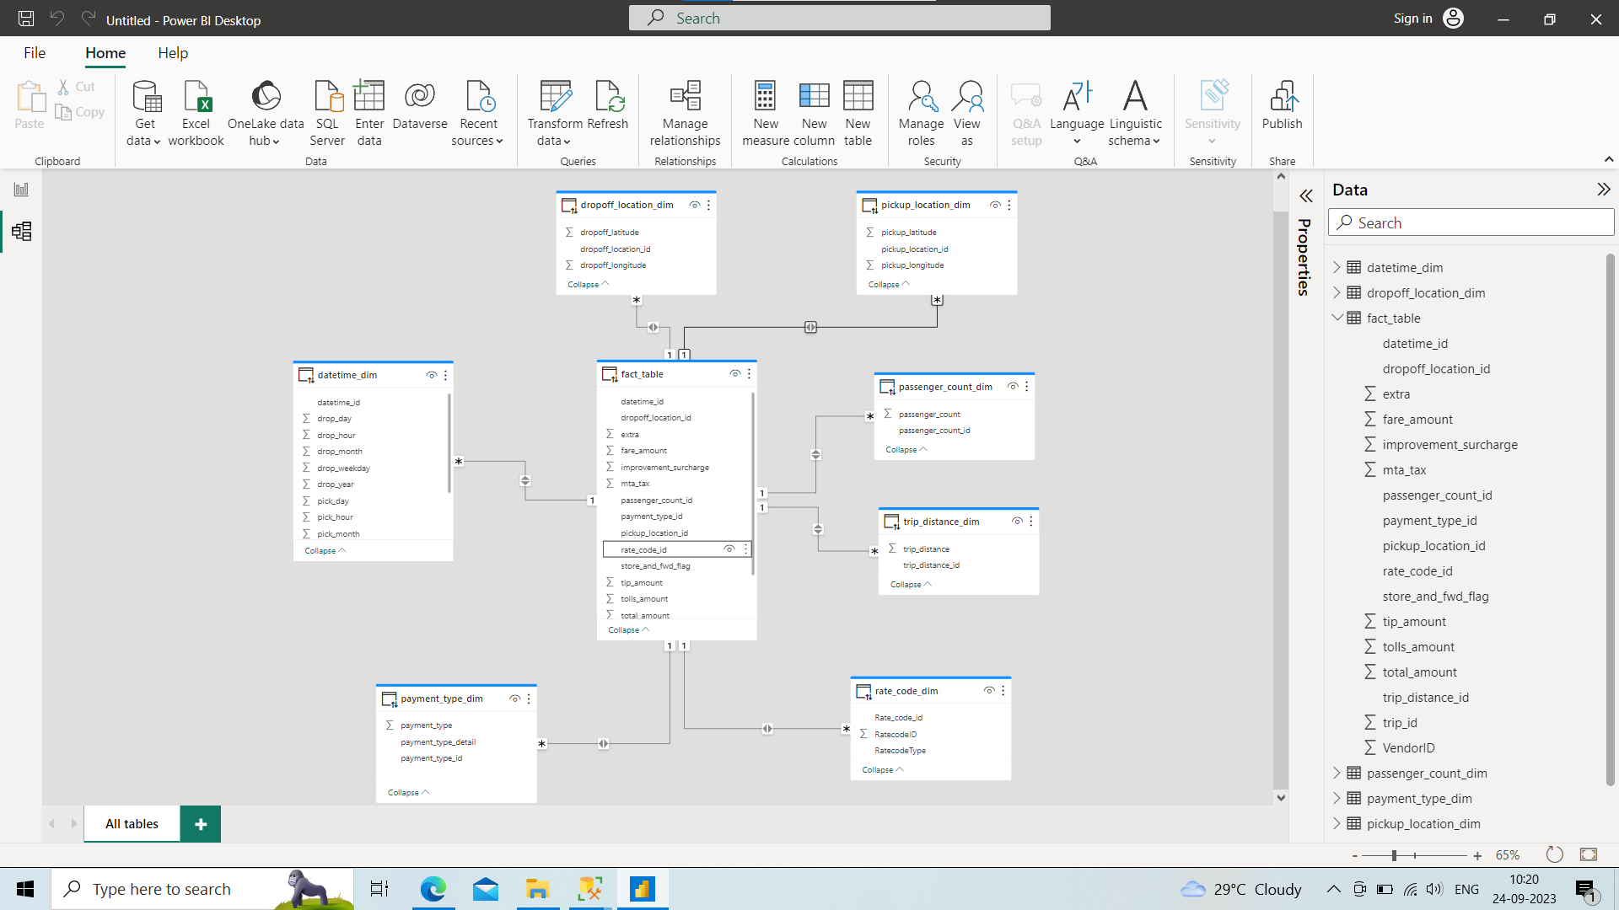

Slide 10
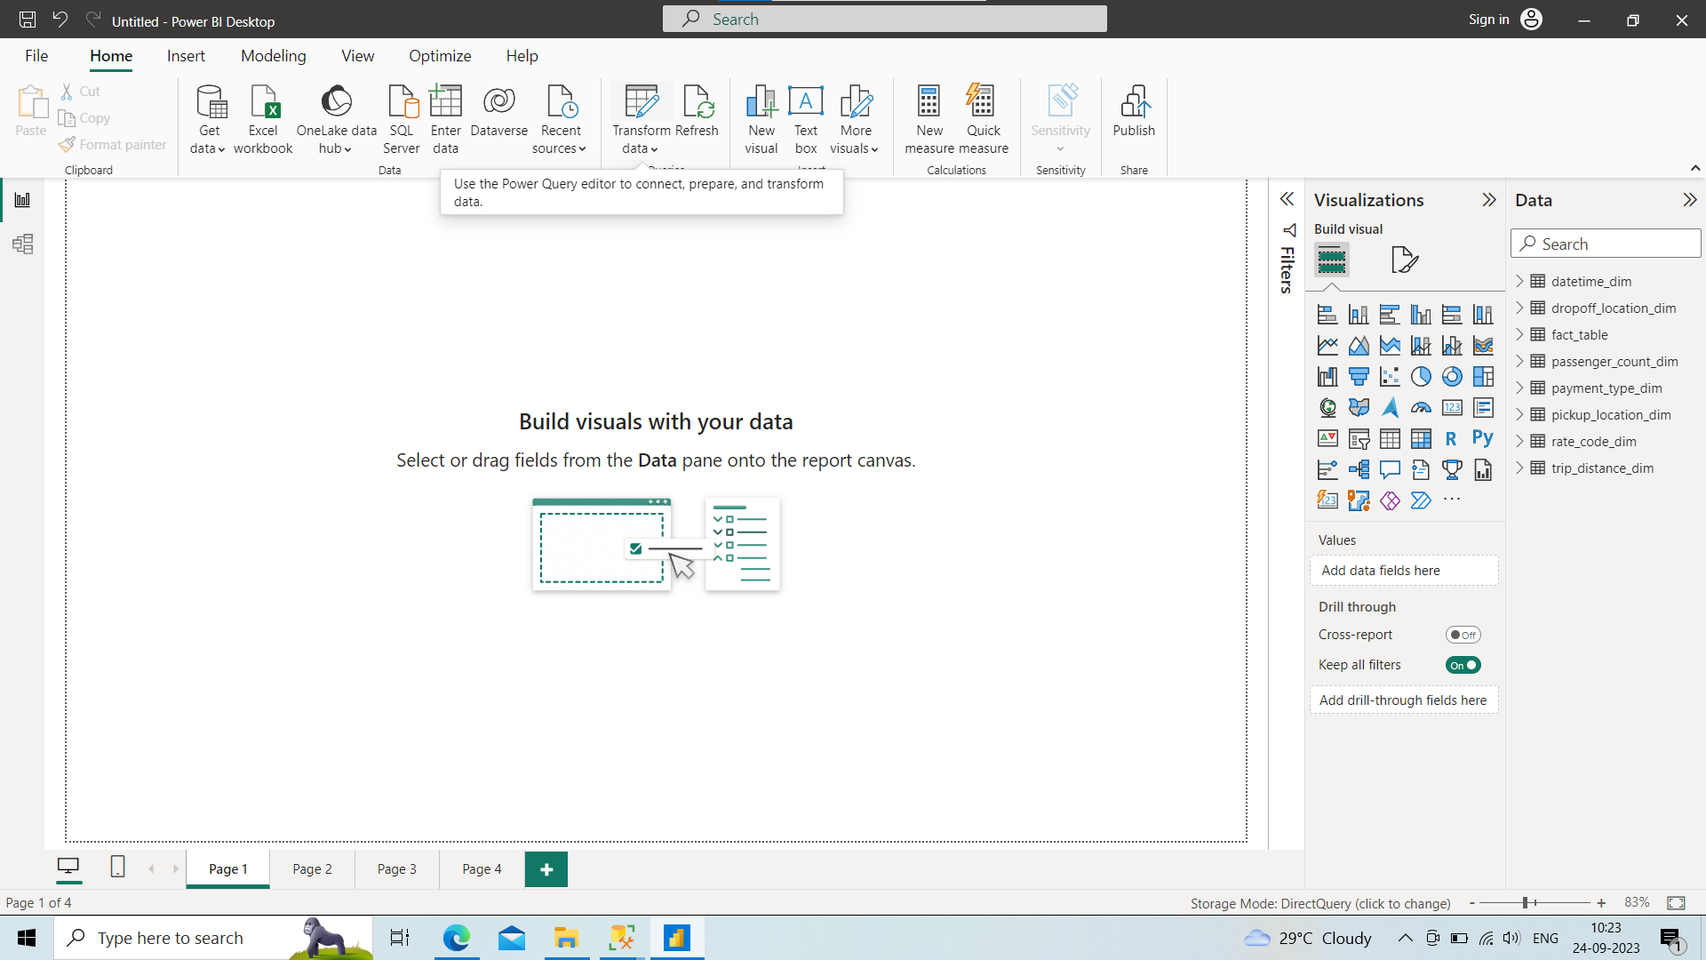
Using power query we can transform our data
But here our data is already transformed for required ad hoc analytics in pyspark

